Slide 1
Technical & Business Writing
Lecture 2
Noreen Shah

Slide 2
Communication is Important to Your Career
Communication is the process of transferring information and meaning between senders and
receivers.
Ambition and great ideas aren’t enough; you need to be able to communicate with people to succeed in business.
Strong communication skills give you an advantage in the job market.

Slide 3
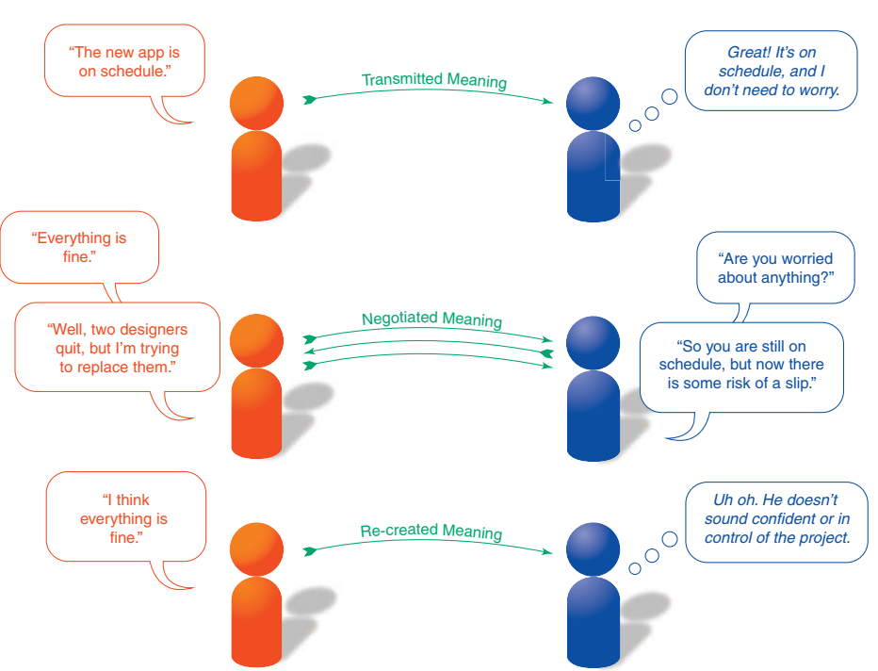
Figure 1.1 Sharing Information
These three exchanges between a software project manager (left) and his boss (right) illustrate the variety of ways in which information is shared between senders and receivers. In the top exchange, the sender’s meaning is transmitted intact to the receiver, who accepts what the sender says at face value. In the middle exchange, the sender and receiver negotiate the meaning by discussing the situation. The negotiated meaning is that everything is fine so far, but the risk of a schedule slip is now higher than it was before. In the bottom exchange, the receiver has a negative emotional reaction to the word think and as a result creates her own meaning—that everything probably is not fine, despite what the sender says.

Slide 4
COMMUNICATION IS IMPORTANT TO YOUR COMPANY
Effective communication helps businesses in numerous ways, by promoting:
●● A stronger sense of trust between individuals and organizations
●● Closer ties with important communities in the marketplace
●● Opportunities to influence conversations, perceptions, and trends
●● Increased productivity and faster problem solving
●● Better financial results and higher return for investors
●● Earlier warning of potential problems, from increasing business costs to critical safety issues
●● Stronger decision making based on timely, reliable information
●● Clearer and more persuasive marketing messages
●● Greater employee engagement with their work, leading to higher employee satisfaction and lower employee turnover

Slide 5
WHAT MAKES BUSINESS COMMUNICATION EFFECTIVE?
To make your communication efforts as effective as possible, focus on making them practical, factual, concise, clear, and persuasive:
●● Provide practical information. Give recipients useful information, whether it’s to help them perform a desired action or understand a new company policy.
●● Give facts rather than vague impressions. Use concrete language, specific detail, and information that is clear, convincing, accurate, and ethical. Even when an opinion is called for, present compelling evidence to support your conclusion.
●● Present information in a concise, efficient manner. Concise messages show respect for people’s time, and they increase the chances of a positive response. Do your best to simplify complex subjects to help your readers, and make sure you don’t inadvertently complicate simple subjects through careless writing.7 The ability to explain a complex subject in simple terms is immensely valuable, whether you’re training new employees or pitching a business plan to investors.
●● Clarify expectations and responsibilities. Craft messages to generate a specific response from a specific audience. When appropriate, clearly state what you expect from audience members or what you can do for them.
●● Offer compelling, persuasive arguments and recommendations. Show your readers precisely how they will benefit by responding to your message in the way you want them to.

Slide 6
Communicating as a Professional
Professionalism is the quality of performing at a high level and conducting oneself with purpose and pride. It means doing more than putting in the hours and collecting a paycheck: True professionals go beyond minimum expectations and commit to making meaningful contributions. Professionalism can be broken down into six distinct traits: striving to excel, being dependable and accountable, being a team player, demonstrating a sense of etiquette, making ethical decisions, and maintaining a positive outlook.

Slide 7
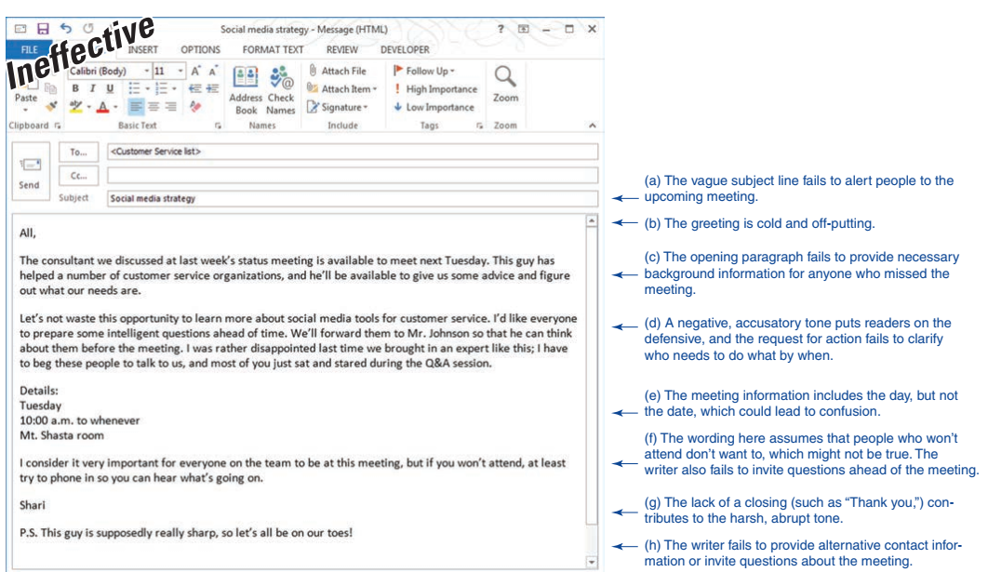

Slide 8
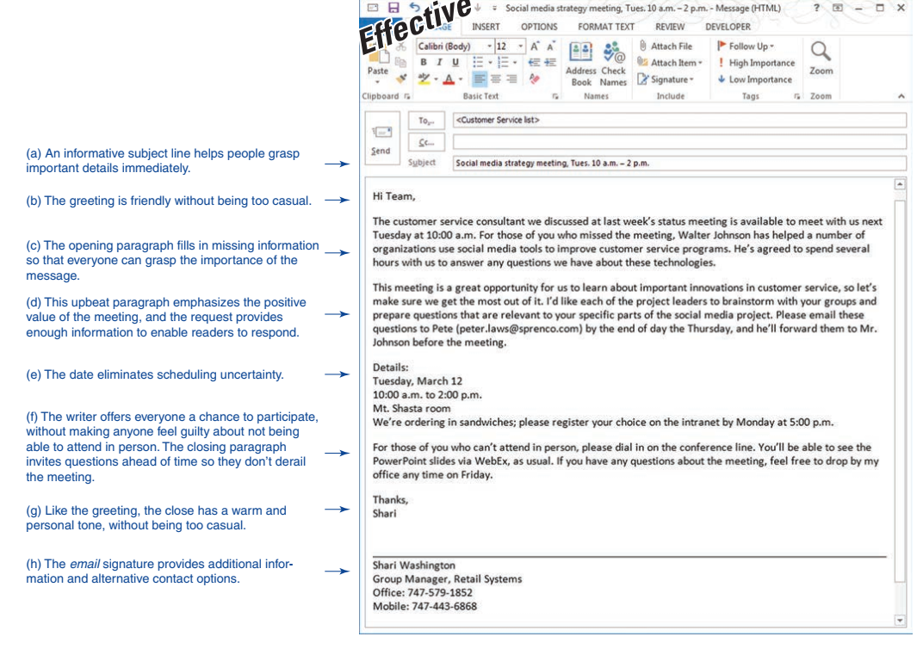

Slide 9
Effective Professional Communication
At first glance, the top email message here looks like a reasonable attempt at communicating with the members of a project team. However, compare it with the bottom version by referencing the notes lettered (a) through (h) to see just how many problems the original message really has.

Slide 10
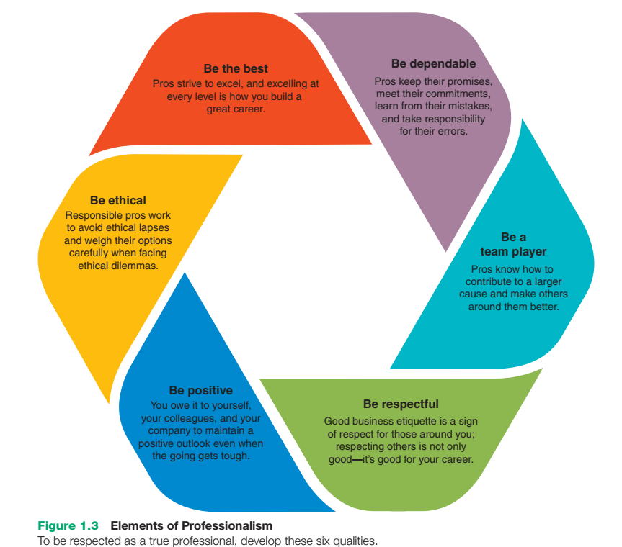

Slide 11
UNDERSTANDING WHAT EMPLOYERS EXPECT FROM YOU
● Recognizing information needs, using efficient search techniques to locate reliable sources of information (particularly from online sources), and using gathered information ethically; this collection of skills is often referred to as digital information fluency9
●● Organizing ideas and information logically and completely
●● Expressing ideas and information coherently, persuasively, and concisely
●● Actively listening to others
●● Communicating effectively with people from diverse backgrounds and experiences
●● Using communication technologies effectively and efficiently
●● Following accepted standards of grammar, spelling, and other aspects of high-quality writing and speaking
●● Communicating in a civilized manner that reflects contemporary expectations of business etiquette, even when dealing with indifferent or hostile audiences
●● Communicating ethically, even when choices aren’t crystal clear or you have to share news that people don’t want to hear
● Managing your time wisely and using resources efficiently
●● Using critical thinking, which is the ability to evaluate evidence completely and objectively in order to form logical conclusions and make sound recommendations

Slide 12
COMMUNICATING IN AN ORGANIZATIONAL CONTEXT
Every organization has a formal communication network, in which ideas and information flow along the lines of command (the hierarchical levels) in the company’s organization structure (see Figure 1.4). Throughout the formal network, information flows in three directions. Downward communication flows from executives to employees, conveying executive decisions and providing information that helps employees do their jobs. Upward communication flows from employees to executives, providing insight into problems, trends, opportunities, grievances, and performance, thus allowing executives to solve problems and make intelligent decisions. Horizontal communication flows between departments to help employees share information, coordinate tasks, and solve complex problems.10
Every organization also has an informal communication network, often referred to as the grapevine or the rumor mill, which encompasses all communication that occurs outside the formal network. Some of this informal communication takes place naturally as a result of employee interaction on the job and in social settings, and some of it takes place when the formal network doesn’t provide information that employees want. In fact, the inherent limitations of formal communication networks helped spur the growth of social media in the business environment.

Slide 13
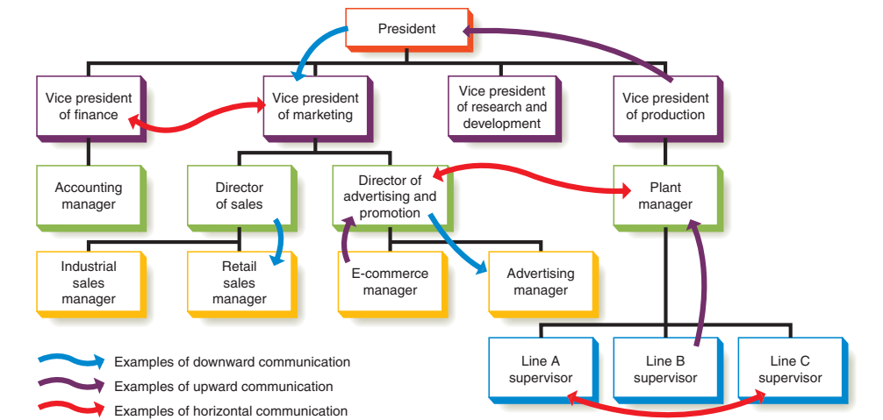

Slide 14
ADOPTING AN AUDIENCE-CENTERED APPROACH
An audience-centered approach involves understanding, respecting, and meeting the needs of your audience members.

Slide 15
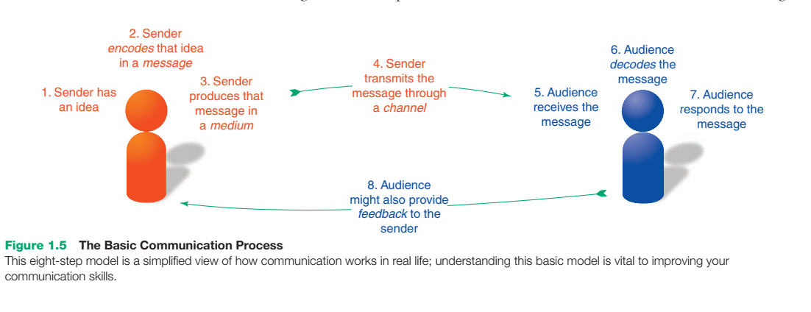
Exploring the Communication Process

Slide 16
THE BASIC COMMUNICATION MODEL
By viewing communication as a process (Figure 1.5), you can identify and improve the skills you need to be more successful. Many variations on this process model exist, but these eight steps provide a practical overview:
●● The sender has an idea. Whether a communication effort will ultimately be effective starts right here and depends on the nature of the idea and the motivation for sending it. For example, if your motivation is to offer a solution to a problem, you have a better chance of crafting a meaningful message than if your motivation is merely to complain about a problem.
●● The sender encodes the idea as a message. When someone puts an idea into a message—which you can think of as the “container” for an idea—he or she is encoding it, or expressing it in words or images. Much of the focus of this course is on developing the skills needed to successfully encode your ideas into effective messages.
●● The sender produces the message in a transmittable medium. With the appropriate message to express an idea, the sender now needs a communication medium to present that message to the intended audience. To update your boss on the status of a project, for instance, you might have a dozen or more media choices, from a phone call to an instant message to a slideshow presentation.
●● The sender transmits the message through a channel. Just as technology continues to increase the number of media options at your disposal, it continues to provide new communication channels you can use to transmit your messages. The distinction between medium and channel can get a bit murky, but think of the medium as the form a message takes (such as a Twitter update) and the channel as the system used to deliver the message (such as a mobile phone).

Slide 17
THE BASIC COMMUNICATION MODEL
●● The audience receives the message. If the channel functions properly, the message reaches its intended audience. However, mere arrival at the destination is no guarantee that the message will be noticed or understood correctly. As “How Audiences Receive Messages” (page 60) explains, many messages are either ignored or misinterpreted as noise.
●● The audience decodes the message. After a message is received, the receiver needs to extract the idea from the message, a step known as decoding. “How Audiences Decode Messages” (page 61) takes a closer look at this complex and subtle step in the process.
●● The audience responds to the message. By crafting messages in ways that show the benefits of responding, senders can increase the chances that recipients will respond in positive ways. However, as “How Audiences Respond to Messages” (page 62) points out, whether a receiver responds as the sender hopes depends on the receiver (1) remembering the message long enough to act on it, (2) being able to act on it, and (3) being motivated to respond.
●● The audience provides feedback to the sender. In addition to responding (or not responding) to the message, audience members may give feedback that helps the sender evaluate the effectiveness of the communication effort. Feedback can be verbal (using written or spoken words), nonverbal (using gestures, facial expressions, or other signals), or both. Just like the original message, however, this feedback from the receiver also needs to be decoded carefully. A smile, for example, can have many meanings.
Considering the complexity of this process—and the barriers and distractions that often stand between sender and receiver—it should come as no surprise that communication efforts often fail to achieve the sender’s objective. Fortunately, the better you understand the process, the more successful you’ll be.

Slide 18
BARRIERS IN THE COMMUNICATION ENVIRONMENT
Noise and distractions.
Competing messages.
Filters.
Channel breakdowns.

Slide 19
INSIDE THE MIND OF YOUR AUDIENCE
How Audiences Receive Messages To truly receive a message, audience members need to sense it, select it, then perceive it as a message.
Consider audience expectations. To improve the odds that your messages will be successfully perceived by your audience, pay close attention to expectations, ease of use, familiarity, empathy, and technical compatibility
Ensure ease of use.
Emphasize familiarity.
Practice empathy.
Design for compatibility.
How Audiences Decode Messages Decoding is a complex process; receivers often extract different meanings from messages than senders attempt to encode in them.
perception of reality
Selective perception

Slide 20
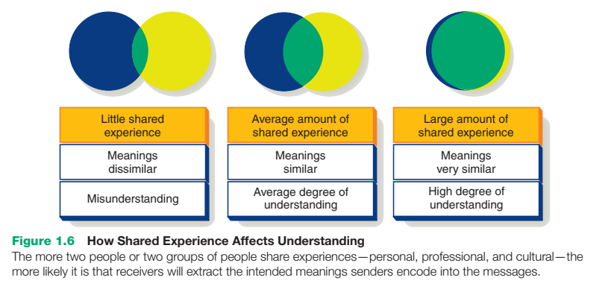
INSIDE THE MIND OF YOUR AUDIENCE

Slide 21
INSIDE THE MIND OF YOUR AUDIENCE
How Audiences Respond to Messages
Audiences will likely respond to a message if they remember it, if they’re able to respond, and if they’re properly motivated to do so. By explaining how audiences will benefit by responding positively to your messages, you’ll increase their motivation to respond.

Slide 22
THE FUTURE OF COMMUNICATION THE INTERNET OF THINGS
The Internet of Things (IoT) refers to the billions of devices now connected to the Internet and the networking potential of having all these gadgets communicate with each other, feed data into vast information warehouses, and interact with people and the physical environment. These “things” range from simple sensors that measure temperature, location, and other parameters all the way up to robots and other complex systems. People and animals with Internet-capable sensors (such as implanted chips) or devices also qualify as things in this model. Imagine you walk into a department store and your mobile phone automatically gives you directions to the aisle where you could find the clothing styles you have recently been browsing online or discussing in social media. When you reach that aisle and start browsing, a coupon pops up on your phone, offering discounts on the specific items you’re considering. When you pull a garment off the rack, the store’s customer database checks other purchases you’ve made and suggests which items you already own that coordinate with this piece. If you could use an accessory to complete the outfit, the store’s computers can tell your phone just where to take you. And if you need more advice, you can text or talk—and possibly not know whether you’re conversing with a store employee or an automated chatbot on a computer somewhere. Now imagine this simple concept expanded and applied in various ways to industrial facilities, agriculture, transportation, buildings, health care, and other systems. By relying on networked IoT devices for such communication functions as observing, measuring, and reporting, these enhanced systems can supplement or replace communication flows that were previously carried out by human participants. IoT is poised to reshape many business processes on a scale that some experts compare to the Industrial Revolution of the 19th century. It also seems likely to influence business communication as it takes over some routine tasks and brings the power of smart networking and computing to others. Basic communication skills will remain as essential as ever, but don’t be surprised if some of the conversations you have in the future aren’t with your fellow humans.
WHAT’S YOUR PREDICTION?
Research the current state of IoT innovation to identify one way in which the technology has the potential to change business communication practices, such as automated report writing or conversational bots that mimic human speech or writing. Do you agree with the predictions the experts make? Why or why not?

Slide 23
THE SOCIAL COMMUNICATION MODEL
The conversational and interactive social communication model is revolutionizing business communication.
The social communication model can increase the speed of communication, reduce costs, improve access to expertise, and boost employee satisfaction.
For all their advantages, social media tools also present a number of communication challenges.

Slide 24
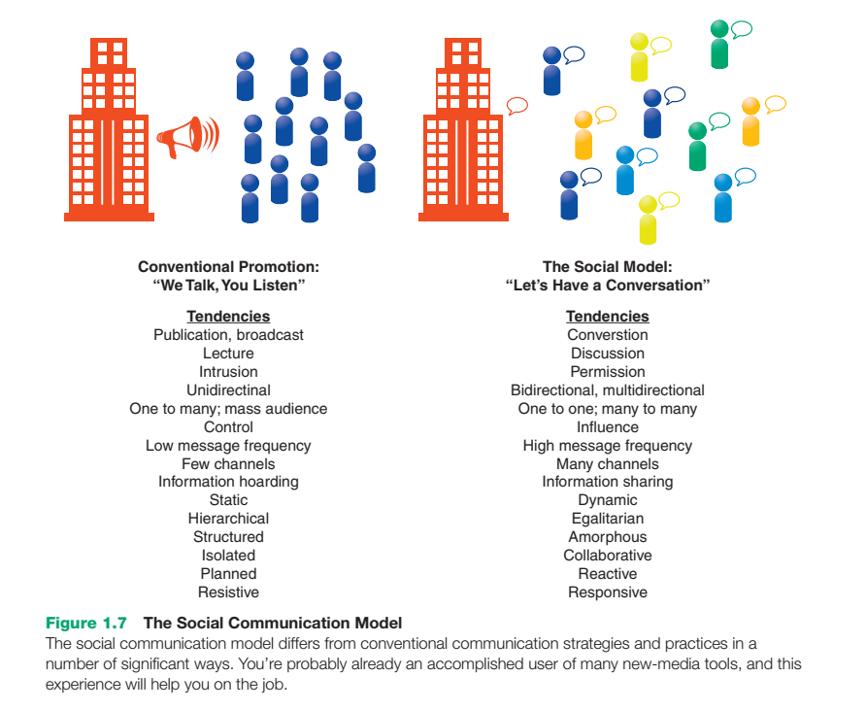
THE SOCIAL COMMUNICATION MODEL

Slide 25
THE MOBILE REVOLUTION
Companies recognize the value of integrating mobile technology, from communication platforms to banking to retail. Mobile apps and communication systems can boost employee productivity, help companies form closer relationships with customers and business partners, and spur innovation in products and services

Slide 26
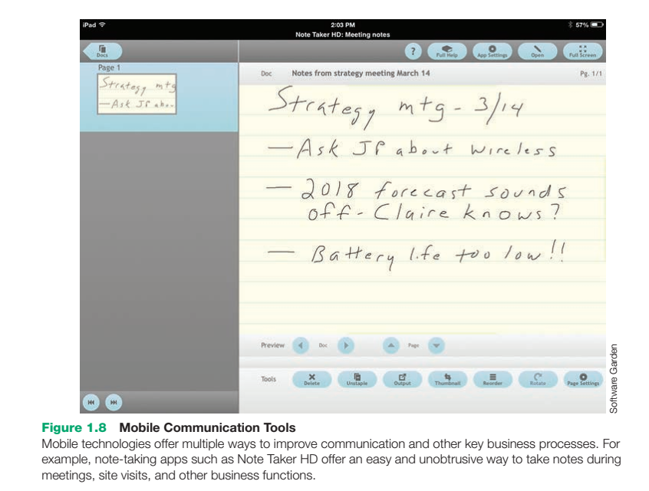
THE MOBILE REVOLUTION

Slide 27
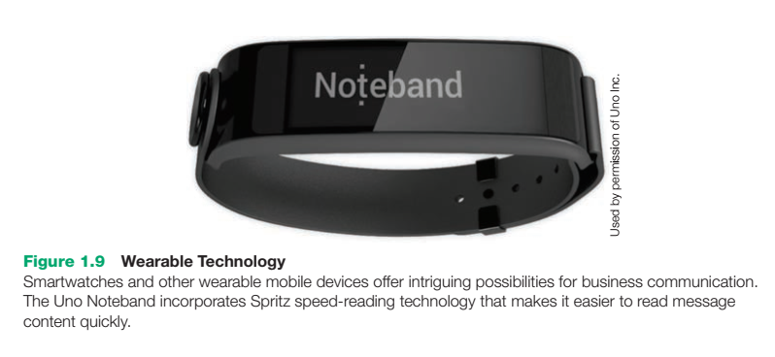
THE RISE OF MOBILE AS A COMMUNICATION PLATFORM
Mobile devices are rapidly taking over as the primary communication platform for many business professionals.
HOW MOBILE TECHNOLOGIES ARE CHANGING BUSINESS COMMUNICATION

Slide 28
THE RISE OF MOBILE AS A COMMUNICATION PLATFORM
People who grew up with mobile phones often expect to have the same level of connectivity in their roles as both customers and as employees.
Constant connectivity is a mixed blessing: You can work from anywhere at any time, but it’s more difficult to disconnect from work and recharge yourself. Mobile users are often multitasking—roughly half of mobile phone usage happens while people are walking, for instance—so they can’t give full attention to the information on their screens.36 Moreover, mobile use often occurs in environments with multiple distractions and barriers to successful communication.
Mobile communication, particularly text messaging, has put pressure on traditional standards of grammar, punctuation, and writing in general. Chapter 4 has more on this topic.
Mobile devices can serve as sensory and cognitive extensions.37 For example, they can help people experience more of their environment (such as augmented reality apps that superimpose information on a live camera view) and have instant access to information without relying on faulty and limited human memory. The addition of location-aware content, such as facility maps and property information, enhances the mobile experience.

Slide 29
THE RISE OF MOBILE AS A COMMUNICATION PLATFORM
Mobile devices create a host of security and privacy concerns for end users and corporate technology managers alike.38 Companies are wrestling with the “bring your own device” or “BYOD” phenomenon, in which employees want to be able to access company networks and files with their personal smartphones and tablets, both in the office and away from it. These devices don’t always have the rigorous security controls that corporate networks need, however, and users don’t always use the devices in secure ways.
Mobile tools can enhance productivity and collaboration by making it easier for employees to stay connected and giving them access to information and work tasks during forced gaps in the workday or while traveling.39
Mobile apps can assist in a wide variety of business tasks, from research to presentations40 (see Figure 1.10). Companies aren’t restricted to commercially available apps, either. With digital publishing tools, companies can create custom apps with content and capabilities geared specifically toward their customers or employees.

Slide 30
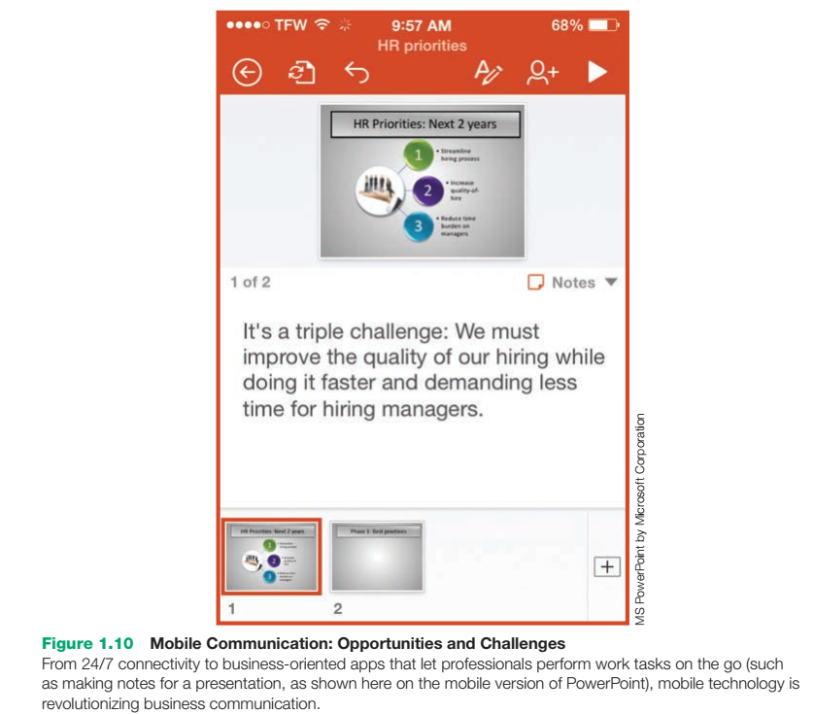

Slide 31
USING TECHNOLOGY TO IMPROVE BUSINESS COMMUNICATION
KEEPING TECHNOLOGY IN PERSPECTIVE: Don’t rely too much on technology or let it overwhelm the communication process.
GUARDING AGAINST INFORMATION OVERLOAD: Information overload results when people receive more information than they can effectively process. An important step in reducing information overload is to avoid sending unnecessary messages.
USING TECHNOLOGICAL TOOLS PRODUCTIVELY: Communicating in today’s business environment requires at least a basic level of technical competence.
WhatsApp lets you send and receive messages, videos, and other content via your phone’s Internet connection.
Pocket collects content you’d like to read or view later and syncs it across your mobile devices.

Slide 32
DIGITAL 1 SOCIAL 1 MOBILE: TODAY’S COMMUNICATION ENVIRONMENT
it’s all fun and games—and effective Business Communication The fact that millions of people spend billions of hours playing games on their mobile devices is not lost on companies looking for ways to enhance communication with employees and customers. Whether they feature skill, chance, or compelling story lines, successful games try to engage users intellectually and emotionally—just as successful business communicators try to do.
Gamification is the addition of game-playing aspects to an activity or a process with the goal of increasing user engagement, and it’s a natural fit for social media and mobile devices. Foursquare’s check-in competitions, in which the person who “checks in” using Foursquare the most times during a certain time window is crowned the “mayor” of that location, were an early use of gamification. Foursquare wasn’t invented as a way for people to become imaginary mayors of places where they shop or eat, of course. It is an advertising platform that relies on user activity and user-generated content, and the game element encourages people to use the app more frequently

Slide 33
DIGITAL 1 SOCIAL 1 MOBILE: TODAY’S COMMUNICATION ENVIRONMENT
Foursquare is a simple example of gamification, but other companies are pushing the concept in new ways to engage and motivate employees and other stakeholders. For example, Bunchball’s Nitro software applies gamification concepts to a number of business communication platforms. On a customer-service system, the software rewards employees for increasing their productivity, meeting their service commitments to customers, and sharing knowledge with their colleagues. On several collaboration and brainstorming systems, gamification encourages people to make more connections, share ideas, and boost their influence within a community. Employee orientation systems can use game concepts to help new hires learn their way around the organization.
Gamification is also a key strategy for many companies trying to improve customer loyalty. Badgeville’s Reputation Mechanics system, for example, boosts the profile of knowledgeable customers who share expertise on social media sites and other online forums. By rewarding their product champions (see page 393) this way, companies encourage them to keep contributing their expertise, thereby helping other customers be successful and satisfied.

Slide 34
DIGITAL 1 SOCIAL 1 MOBILE: TODAY’S COMMUNICATION ENVIRONMENT
Incidentally, if you are in the Millennial generation— those born between about 1981 and 1995—you’re a special target of gamification in the workplace and the marketplace, given your generation’s enthusiasm for video games. Don’t be surprised to find more gamified apps and systems on the job and everywhere you turn as a consumer.
CAREER APPLICATIONS
1. Gamification is about influencing employee and customer behaviors in ways that benefit a company. Is this ethical? Explain your answer.
2. Assume a company provides a job-search game app that helps you navigate your way through applying for a job, explore various job openings, and understand what it would be like to work there. Would the app make you feel more positively about the company, or would you find that using a game for this purpose would trivialize something as important as your job search? Explain your answer.

